Slide 1
National HERE Seminar
“HEI-Business partnerships as drivers for economic development in Albania”
Theme: Strong relation
Tirana, 4th of April 2024
The strong relation between Universities, Entrepreneurship & Innovation 4th of April 2024 Mrs. Albana Laknori Secretary General

Slide 2
CCIT - the leading business organization!
Established since 1897, CCIT is the legitimate representative and advocate of business community’s voice;
Since 2008, membership in the chamber is voluntary;
Under the jurisdiction of CCIT, the business of Tirana Region contributes with over 40% of the country’s GDP; 40% total exports;
30% of the total number of active enterprises operate at Tirana District; 36.6% of companies are managed by women, and 67% of the total number of foreign enterprises and joint ventures;
Tirana regional economy is dominated by trade and tourism sector that contribute with 22% construction with 13% and activities of public administration with 14.7%;

Slide 3
CCIT services
Advocacy services: Enable a unified voice for members and lobby for better formulation of policies of business interest, fiscal issues, administrative barriers, investment climate, etc .;
Commercial information services: consular services, issuance of verbal grades; certificate of origin for products in non-EU countries;
Promotion of international trade / promotional activities for exports / trade fairs and exhibitions;
Education and training;
Relations with economic diplomacy for the presentation of the potentials of Albanian products and services in foreign markets;
Organizing business forums;
Memorandum of Cooperations with various business organizations inside and outside the country;
Bilateral and regional agreements;

Slide 4
CCIT- Objectives
The aim of CCI Tirana is to contribute to the realization of business missions with international partners in Albania or in other foreign countries with its own initiative as well as a part of the government delegations, attracting foreign investments to Albania and cooperation with Albanian investors.
1. Promotion and support of exporting manufacturing enterprises and their internationalization
2. Promotion and development of professional and "dual" education and training, based on the best European models
CCIT aims to:
3. Encouraging investment projects, especially in the green economy/environmental protection, renewable energy, and recycling economy, that contribute to the development of a competitive economy.
4. Development of skills and professional qualifications in accordance with the European agenda 2023, to respond to the needs of the labor market.

Slide 5
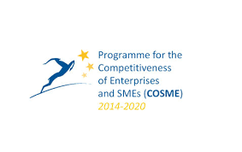
European Program Projects

Slide 6
CCIT has established the Centre of Research and Trainings for Business since March 2009. This center provides support for business through personalized trainings, the raise of the awareness as well as the establishment of the coordination and cooperation mechanisms intending to:
Develop the business innovation and particularly in support for SMEs and start -ups. To establish a functional communication and the creation of the coordinating mechanisms and means among the research, education and training institutions domestically and abroad, in order to increase the cooperation, the exchange of the ideas and the experience in the fields of professional background and the applicative research for the business, and for internationalization of the SMEs.
in Erasmus projects CCIT has a key role in connecting businesses with institutions of education; bringing best practices to WB from EU partner countries ect

Slide 7
During these years starting from (2018-2023), CCI-Tirana has managed more than 25 projects, implemented mainly in cooperation with partners from EU countries, such as Interreg, Erasmus +, Cosme programs, etc.
The focus is on supporting entrepreneurship, competitiveness, innovation, capacity building, monitoring, and adoption of best models/practices.
Partnerships with Chambers and not only (HEIs, various associations, local and central institutions, etc.) in countries that are part of the EU and outside it, such as: Italy, Montenegro, Greece, Croatia, Slovenia, Bosnia and Herzegovina, Serbia; Cyprus; Spain; North Macedonia etc
Projects that on themain focus have triple or quadruple helix
U-SIA; GRADUA; DERHE ; ADDUPT; HISTEK

Slide 8
USIA “University to Society Innomediaries in Albania: Co-Production of knowledge and research that matters” or USIA is a Capacity Building Project in Higher Education
USIA brings together universities, civil society organizations, public institutions, and business organizations to enhance an enabling higher education environment that supports university-to-society collaborations to co-produce knowledge and research with an impact that is not only academically insightful but also applicable to the development of Albania in light of European integration and current multiple challenges

Slide 9
Addupt project Reinforcing the link between Vocational Education and Training (VET) and the green sector* through a capacity-building program, including workshops, digital resources, and other learning activities.
Focusing on
–building qualification systems,
- improving the quality of the learning processes and
- ensuring the continuing professional development of VET teachers and training.

Slide 10
One Future The broad scope and specific objectives of the project align with the EU's main priority "The Green Deal", as a project that supports action within higher education systems to create climate-resilient communities.
Established in 2019, the 1FUTURE project network is a robust collaboration bringing together Higher Education Institutions from both the EU and the WB region.
This dynamic consortium, enriched by the involvement of business associations, non-profit organizations, and supported by government institutions as associated partners, embodies the quadruple helix model, ensuring a multidisciplinary and diverse collaboration and a robust stakeholder engagement

Slide 11
DERHE - Digital Education Readiness in the field of Higher Education with Faculty of Economics Tirana
Main goal:​
Developing tools and methods to achieve education goals in a blended way requires support and experience from countries and institutions that are ahead in this process. ​
For such methods to be implemented, however, it is necessary to innovate our educational practices, adapt current teaching materials and prepare new learning tools. In order to implement this innovative approach, training of teaching staff is needed. ​
Later, the transfer of acquired knowledge to students and companies will be achieved through project activities.​

Slide 12
CCIT- Network Partnerships

Slide 13
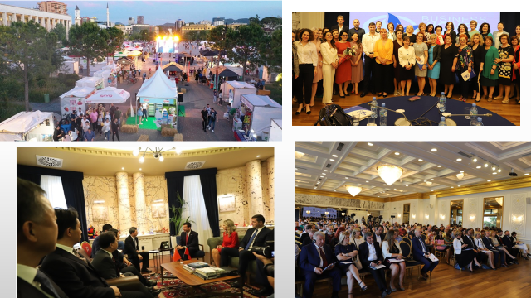

Slide 14
Thank you for your attention!
Faleminderit!
https://www.cci.al/
Rr. e Kavajes, Nd.2, H.2
Tel: +355 (0) 45 800 932

