Slide 1


Centralised Support to the Network of Higher Education Reform Experts (HERE)
HERE ALBANIA Seminar:
Micro-credentials/ implications and points of interest for higher education systems in Partner Countries neighbouring the EU
4-5 April 2024
Background information on: Micro-credentials

Slide 2
What are micro-credentials?
Towards a common understanding
A micro-credential is a small volume of learning certified by a credential. In the EHEA context, it can be offered by higher education institutions or recognised by them using recognition procedures in line with the Lisbon Recognition Convention or recognition of prior learning, where applicable. A micro-credential is designed to provide the learner with specific knowledge, skills or competences that respond to societal, personal, cultural or labour market needs. Micro-credentials have explicitly defined learning outcomes at a QF-EHEA/NQF level, an indication of associated workload in ECTS credits, assessment methods and criteria, and are subject to quality assurance in line with the ESG.
Microbol project
“Micro-credentials certify the learning outcomes of short-term learning experiences, for example a short course or training. They offer a flexible, targeted way to help people develop the knowledge, skills and competences they need for their personal and professional development..”
European Commission
“Micro‐credentials verify, validate and attest that specific skills and/or competencies have been achieved and are endorsed by the issuing institution, having been developed through established faculty governance processes and designed to be meaningful and high quality.”
SUNY Micro‐Credentialing Task Force Report and Recommendations - https://system.suny.edu/media/suny/content-assets/documents/academic-affairs/Micro-Credentialing-TaskForce--Report.pdf

Slide 3
No commonly agreed definition (globally) – but some agreed key characteristics and possible divergences
Formal way of recognising knowledge and skills in a particular area
Technical, professional
Not a qualification
complements or upgrades a qualification
Entry into a non-recognised profession
Shorter & more flexible than “degrees”
Stackable: part of or accumulate into a degree
Not limited to higher education
Credits?
Providers?
Provided in collaboration with/ in response to demand of professional sector
Costs?

Slide 4

Report « Digitally Enhanced Learning and Teaching in European Higher Education Institutions » (DIGI-HE – EU-funded project)
Lifelong learning
Employability
Re- and upskill
People in the workforce
Students
Complement existing study programmes
Another step in the flexible learning path
Survey to HE leadership –
368 responses from all 48 countries of EHEA – Jan. 2021
Purpose of short online courses?

Slide 5
Digi HE: Lifelong Learning - developments & perceptions
48%
digitalisation has contributed to major transformation in widening access
49%
reach out to new learner groups - one of the main motivations for offering MOOCs
65%
mature and adult students are the main target of online learning
81%
widening access through digitalisation is a strategic development priority
growing demand for short courses
65% blended
53% online
44% on campus

Slide 6
The EU policy framework:
Achieving a
European Education Area
by 2025
EUROPEAN UNIVERSITIES
Full roll out
EUROPEAN DEGREE and LEGAL STATUTE
EUROPEAN GRADUATE TRACKING initiaitve
EU
APPROACH TO
MICRO-CREDENTIALS
QUALITY
ASSURANCE and RECOGNITION
system
EUROPEAN STUDENT CARD initiative
Higher Education Transformation
agenda

Slide 7
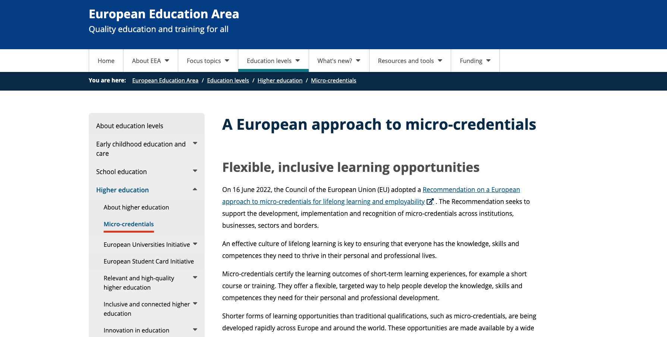
EU Council recommendation on micro-credentials (2022)

Slide 8
The Bologna Process Perspective:
“Flexible and open learning paths, part of the original inspiration for the Bologna Process, are important aspects of student-centred learning and are in increasing demand in our societies. In addition to full degree programmes, many higher education institutions offer or plan to offer smaller units of learning, which enable learners to develop or update their cultural, professional, and transversal skills and competences at various stages in their lives. We ask the BFUG to explore how and to what extent these smaller, flexible units, including those leading to microcredentials, can be defined, developed, implemented and recognised by our institutions using EHEA tools.”
Rome Communiqué 2020

Slide 9
SPHERE virtual seminar November 2020:
Pre-survey
Is the expression of “micro-credential” used in your HE environment?

Slide 10
SPHERE virtual seminar November 2020:
Pre-survey
Where is the demand for this type of credentialing coming from ?

Slide 11
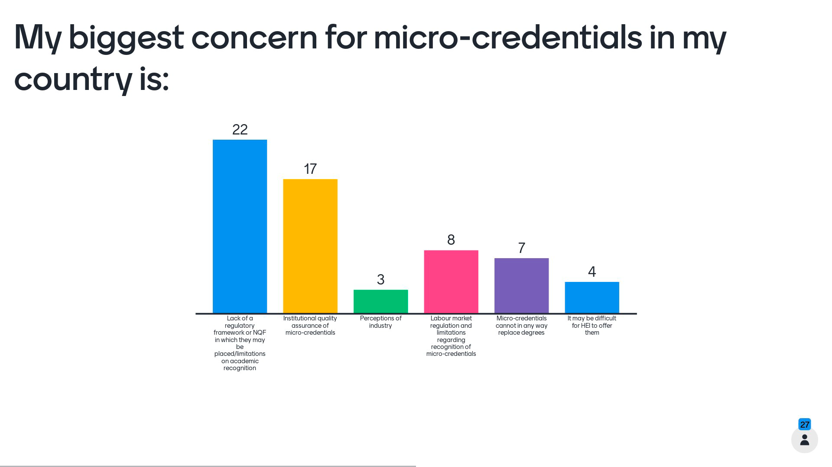
SPHERE virtual seminar November 2020: Post-Survey of participants

Slide 12
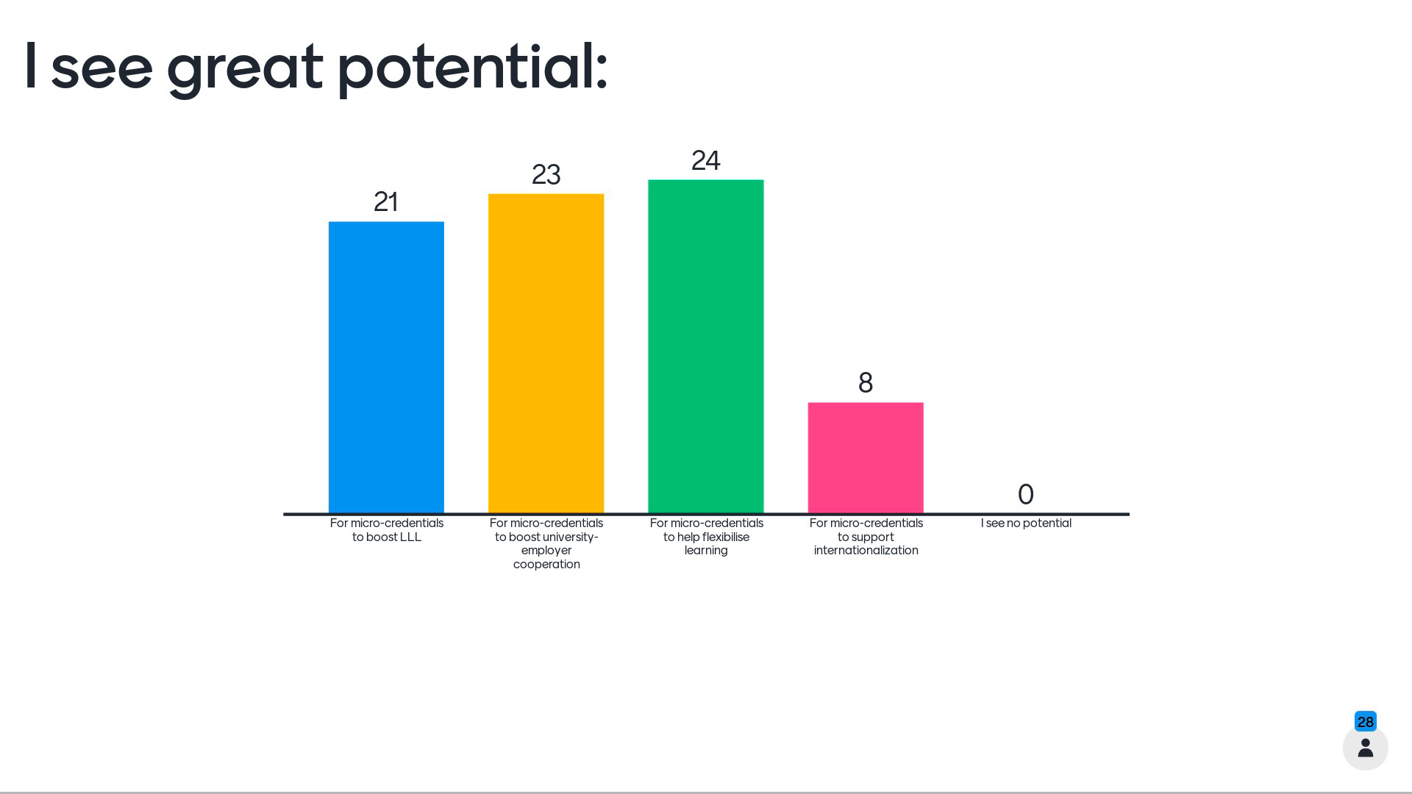
SPHERE virtual seminar November 2020: Post-Survey of participants

Slide 13
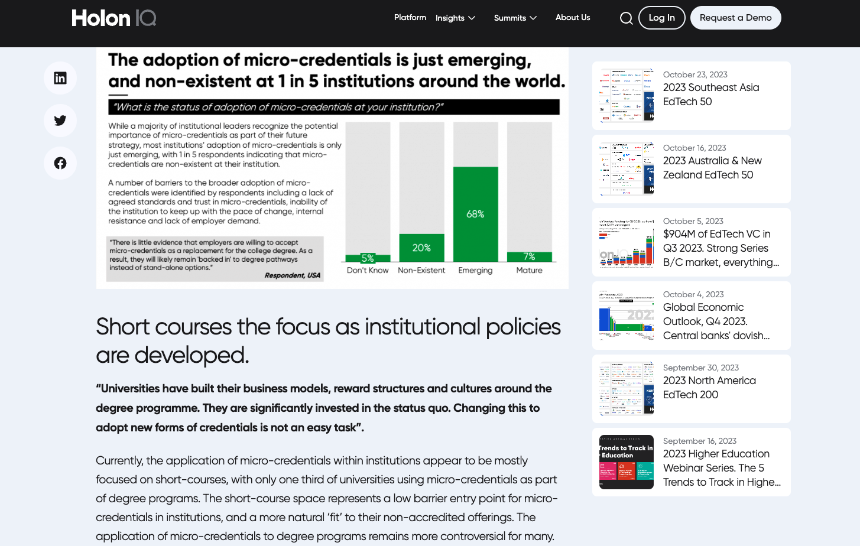
Breaking barriers in flexibilization and digitalization or learning?
Towards institutional policies?

Slide 14
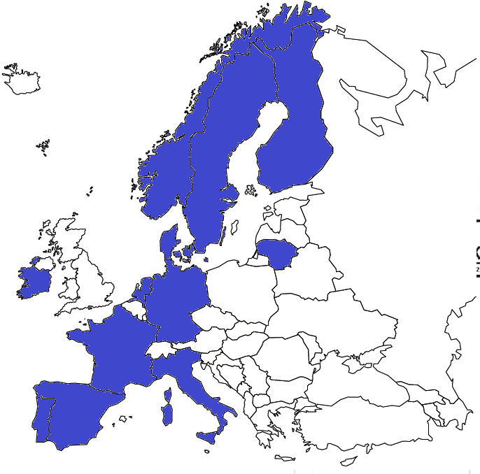















European University Alliances
and micro-credentials: An example
Aalborg University, Denmark
Dublin City University, Ireland
Hamburg University of Technology, Germany
Groupe INSA, France
Kaunas University of Technology, Lithuania
Linköping University, Sweden
Tampere University, Finland
Tecnológico de Monterrey, Mexico
Universitat Autònoma de Barcelona, Spain
Universidade de Aveiro, Portugal
University of Stavanger, Norway
Università di Trento, Italy
University of Twente, The Netherlands

Slide 15

Questions
        How relevant are the EHEA/EU approaches on this topic to your context?
        Do they address the main challenges of your system?
        How interested are HEIs or other stakeholders in your system in micro-credentials? And for what concrete use?
        What do you see as obstacles/ challenges for use and implementation?
        What can be learned from the latest EU/EHEA developments and trends?

Slide 16
Sources and additional reading on micro-credentials
EAIE Forum Employability for the 21st century
ENQA webinar Micro-credentials and the role of external quality assurance
European project MICROBOL (2021). Micro—credentials and Bologna Key commitments. State of the play in the European Higher Education area. ERASMUS+ & European Commission. February.
European Commission (2020). A European approach to micro-credentials background paper for the first meeting of the consultation group on micro-credentials 26 May 2020.
European project MICROBOL. (2021) Micro-credentials linked to the Bologna KeyCommitments.
Kelo, Maria The big new world of micro-credentials. Podcast. Director of the European Association for Quality Assurance in Higher Education (ENQA)
Malik, K. (2012). Effects of modular and traditional approaches on students’ general comprehension. Elixir Social Studies, 42, 6228–6231. [Google Scholar]
Microcredentials.eu: contains key outputs from the recently completed MicroHE project and ongoing MICROBOL project.
Implementation of MOOCs for Micro-Credentials and European University Alliances (2023) : https://www.researchgate.net/publication/371226428_Implementation_of_MOOCs_for_Microcredentials_and_European_University_Alliances
BE Campus Micro-Credential Tool Kit: https://opentextbc.ca/bcmicrocredential/
Strategic Institutional Response to Micro-credentials: Key Questiona for Education Leaders (2023) : https://jime.open.ac.uk/articles/10.5334/jime.801
Holon IQ: Micro-credentials Global Survey: https://www.holoniq.com/notes/micro-credentials-global-panel-results?utm_campaign=Education%20General&utm_content=216581919&utm_medium=social&utm_source=linkedin&hss_channel=lcp-13709137

