Slide 1
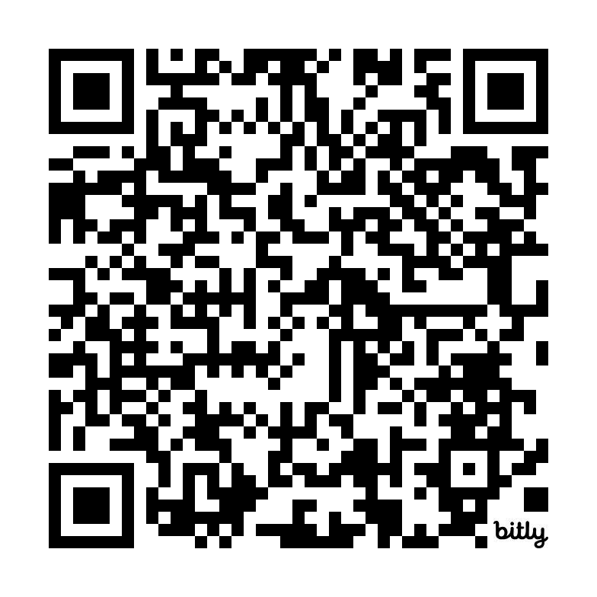
BUILDING A SUSTAINABLE ENTREPRENEURIAL ECOSYSTEM IN ALBANIA
Associate professor (HDR) in Entrepreneurship, TBS Education
Editor Small Business Economics
Associate editor Journal of Small Business Management/ Management & Prospective (Gestion 2000)/RIPME
Assistant Program Chair ENT Div AOM
c.theodoraki@tbs-education.fr
Find the presentation here:
https://bit.ly/SustainableEE-HEREAlbania

Slide 2
Dr. HDR Christina Theodoraki
Associate professor HDR in Entrepreneurship, TBS Education, FR Affiliate professor, International University of Monaco, IAE Paris Pantheon-Sorbonne PDW Chair ENT Division AOM Editor Small Business Economics: An Entrepreneurship Journal Associate editor Journal of Small Business Management Advisory Board Member- Institute for Development Strategies Indiana University, USA Co-leader of the Babson Collaborative Research Group on Entrepreneurial Ecosystems Business Dev. Manager (Entrepreneurial Ecosystem Research Network - EERN)
Distinctions
New publications
Editor Award, Innodays - International Conference for Innovation and Entrepreneurship
Cretan Distinguished Scientists with Excellence in Research
Best Policy Paper ICSB Global Award 2021 Pre-incubation Ecosystem
Babson Collaborative Member of the Year Award 2021
ICSB Resiliency Awards 2020 – Top 1 Best Webinar Understanding Entrepreneurial Ecosystems
ICSB Resiliency Awards 2020 – Top 9 Article How to Build a Sustainable Ecosystem: The Relevance of Governance and Coopetition
Best dissertation award 2018 AEI
Best dissertation award 2018 AIREPME
Recognized Entrepreneurial Ecosystem Builder – ESHIP community – Kauffman
Messeghem, K., Theodoraki, C., Carayannis, E. (2023) Pour une modélisation de l’écosystème entrepreneurial sous forme de sous-écosystèmes : Apport de l’approche des systèmes complexes adaptatifs, Management International
Theodoraki, C., Audretsch, D.B., Pastelakos, E. (2022) The Moderating Effect of Family Firms on SMEs Innovativeness and Internationalization, Revue de l’Entrepreneuriat
Theodoraki, C. (2022), Evolution of Entrepreneurship Research: The Importance of Places, Revue de l’Entrepreneuriat, 21, 75-87, Access.
Sureka, R., Kumar, S., Mukherjee, D., Theodoraki, C. (2022) What restricts SMEs from adopting sophisticated capital budgeting practices? Small Business Economics, Read online.
Cloitre, A., Dos Santos Paulino, V., Theodoraki, C. (2022) The quadruple/quintuple helix model in entrepreneurial ecosystems: an institutional perspective on the space case study, R&D Management, Open Access
Pastelakos, E., Theodoraki, C., Catanzaro, A. (2022) The role of innovation and internationalization support in small- and medium-sized enterprises’ export performance, European Management Review, 1–17. Read online
Theodoraki, C., Dana, L.P., Caputo, A. (2022), Building sustainable entrepreneurial ecosystems: A holistic approach, Journal of Business Research, Early access
Theodoraki, C. ; Messeghem, K. ; Audretsch, D. (2022) The Effectiveness of Incubators’ Co-Opetition Strategy in the Entrepreneurial Ecosystem : Empirical Evidence from France, IEEE TEM, Early access
Theodoraki, C. (2021), Ecosystème entrepreneurial académique : vers l’élaboration d’une stratégie écosystémique efficace, Revue internationale PME, 34(3-4), 68-89. Early access
Lô, A. ; Theodoraki, C. (2021). Achieving Interorganizational Ambidexterity Through a Nested Entrepreneurial Ecosystem, IEEE TEM, 68(2), 418-429 Early access
Theodoraki, C., Catanzaro, A. (2021), Widening the borders of the entrepreneurial ecosystem through the international lens, The Journal of Technology Transfer, Read online
Theodoraki, C. (2020). A Holistic Approach to Incubator Strategies in the Entrepreneurial Support Ecosystem, M@n@gement, Open Access

Slide 3
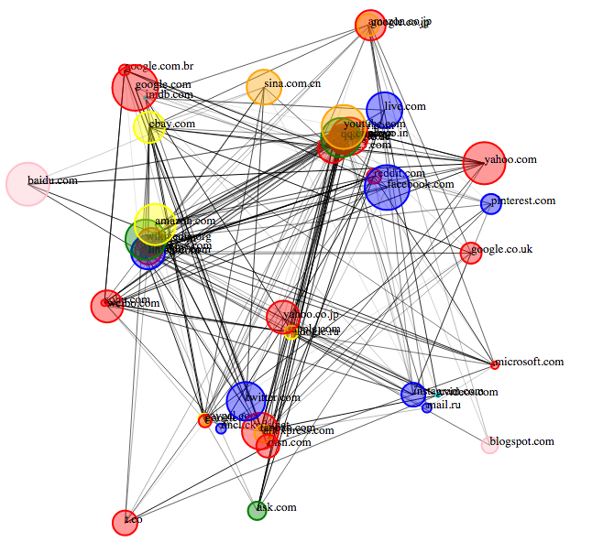
Understanding Entrepreneurial Ecosystems
For more information watch the ICSB Webinar Here:
Webinar Understanding Entrepreneurial Ecosystems
ICSB 2020
Entrepreneurial ecosystem
A multi-faced, multi-level, multi-modal, multi-nodal, multi-disciplinary concept
Notes:
For more information watch the ICSB Webinar Here:
Webinar Understanding Entrepreneurial Ecosystems
https://www.youtube.com/watch?v=HI3KXKxtIBQ&feature=youtu.be

Slide 4
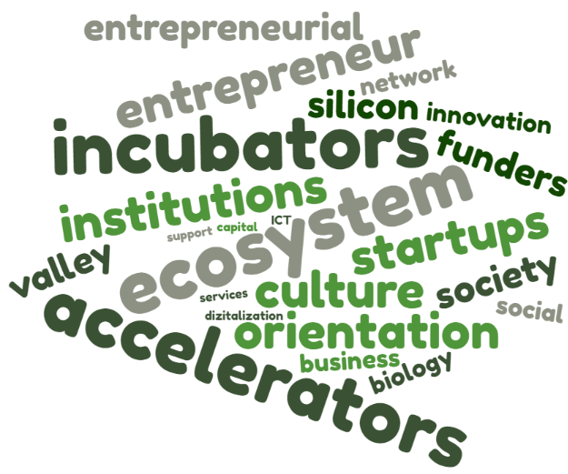
Why this topic?
1
ecosystems
Everyone is using this
2
Multitude of terms and definitions
Resilience
Growth
Top-down
Female
3
Governance
Different directions of development
Measures
Digital
Bottom-up

Slide 5
Why this topic?
15 years of Ecosystem Research
1
Entrepreneurial ecosystem: emerging but under-developed theoretical stream (Spigel, 2017; Wurth et al., 2021)
Its expansion phase has already begun with its acceptance by the academic community (Theodoraki et al., 2022)
ECOSYSTEM THINKING & OPENESS
2
Incubators and Accelerators are key actors of the entrepreneurial ecosystem (Goswami et al., 2018, Van Weele et al., 2018; Theodoraki et al., 2020)
Incubator performance is highly criticized and considered as inefficient due to a lack of a clear strategy (Theodoraki et al., 2020)
STRATEGIC EFFICIENCE
3
Firms should not act as individual entities but as part of an ecosystem (Adner, 2017)
Need to develop holistic views to maintain sustainability (Theodoraki et al., 2018; Theodoraki et al., 2022)
FURTHER UNDERSTANDING

Slide 6
What we need?
Provide the state-of-the-art of entrepreneurial ecosystems
Map the evolution of this emerging field
Describe the main tools, models & tips
Develop the ecosystem sustainability
1
2
3
4

Slide 7
Context: Challenges from Theory & Practice

Slide 8
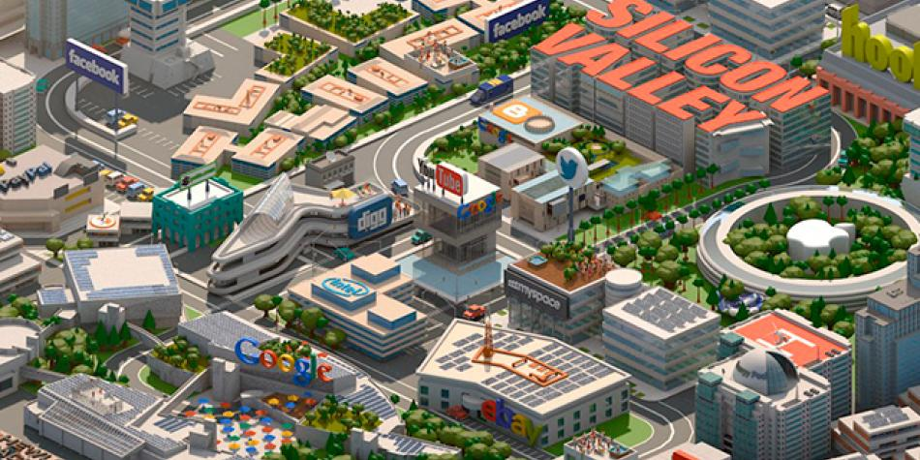
What we want?
The Silicon Valley Myth: Be like Silicon Valley…
Source: newsbeezer.com

Slide 9
A successful ecosystem … is it possible?
Step 1: Make a list
Step 2: Duplicate
Step 3: Recontextualize
Cette photo par Auteur inconnu est soumis à la licence CC BY-SA

Slide 10
The state-of-the-art of entrepreneurial ecosystems

Slide 11
Historic evolution
Biology
Management
Entrepreneurship
Natural ecosystem
Business ecosystem
Entrepreneurial ecosystem
1935
1993
2006
2010
Arthur George Tansley (1871-1955) - British Ecologist
James F. Moore - Harvard Business Review
Boyd Cohen - EADA Business School, co-founder of IoMob
Daniel Isenberg - Babson College Executive Education

Slide 12
What we know?
Entrepreneurial ecosystem: emerging and developing research stream
Growing interest
Emergence
Approval
Expansion
Source: 119 selected articles, Scopus January 2021
Theodoraki, Dana, Caputo, 2022 Building sustainable entrepreneurial ecosystems: A holistic approach, Journal of Business Research, 140, 346-360.

Slide 13
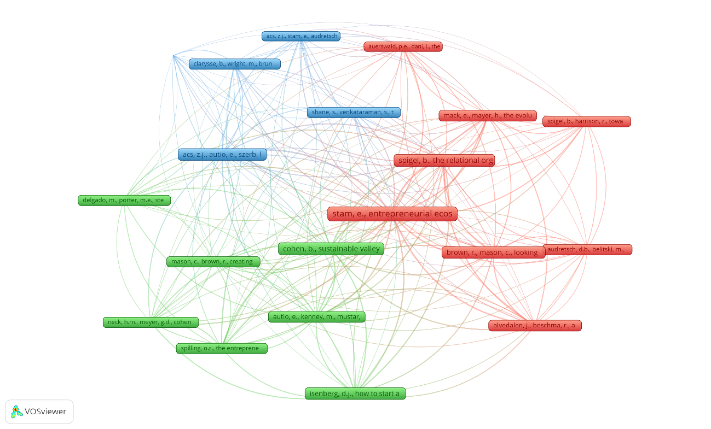
Co-citation card by main contributions
Cluster 3
Cluster 1
Strategic perspective
Ecosystem configuration
Cluster 2
System perspective
Theodoraki, Dana, Caputo, 2022 Building sustainable entrepreneurial ecosystems: A holistic approach, Journal of Business Research, 140, 346-360.

Slide 14
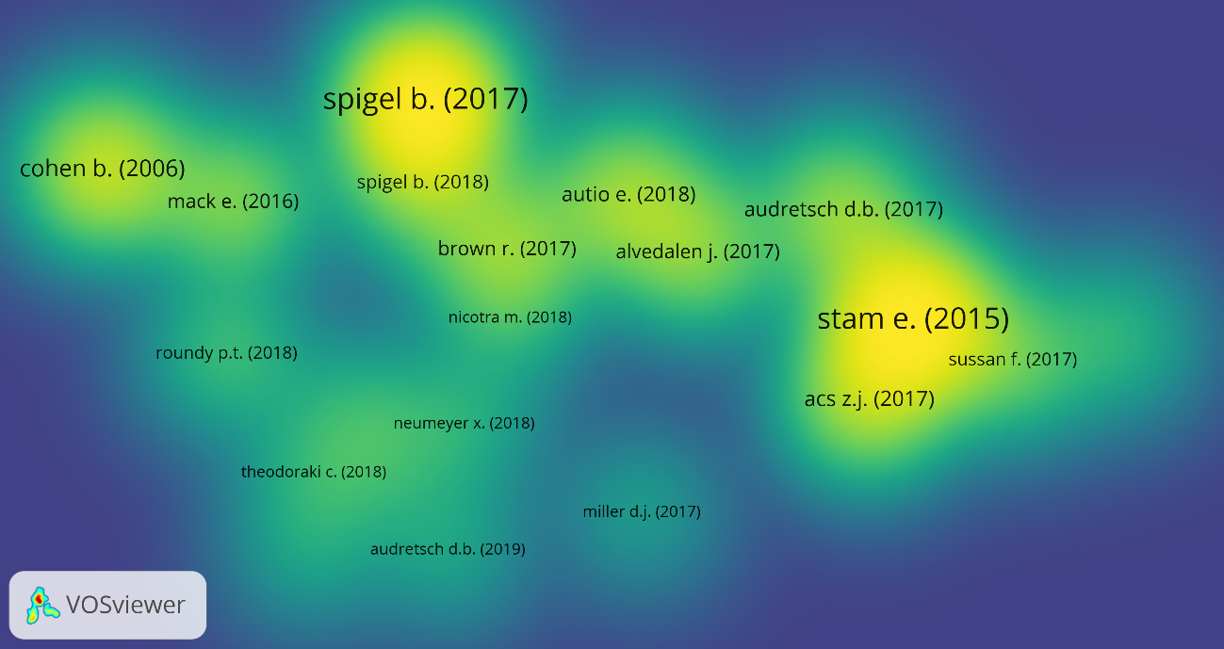
Bibliographic coupling by sources
Evolution
Configuration
Regions
Sustainability
Digital
Measures
Resilience
Social networks
Incubators
Education
System
Societal impacts
119 articles, Scopus, January 2021
Theodoraki, Dana, Caputo, 2022 Building sustainable entrepreneurial ecosystems: A holistic approach, Journal of Business Research, 140, 346-360.

Slide 15
Exploring the Black Box of Ecosystems

Slide 16
What does “ecosystem” mean?

Slide 17
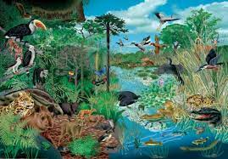
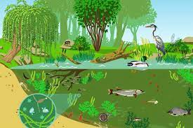
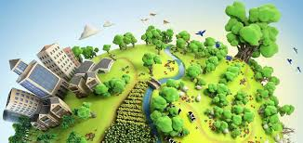
What an “ecosystem” is…

Slide 18
Ecosystem Metaphor: An Umbrella Concept
Platform Ecosystems
Entrepreneurial Ecosystems
ICT Ecosystems
Natural
Ecosystems
Entrepreneurship Educational Ecosystems
Business Ecosystems
Innovation Ecosystems
Knowledge Ecosystems
Local/Regional Ecosystems

Slide 19
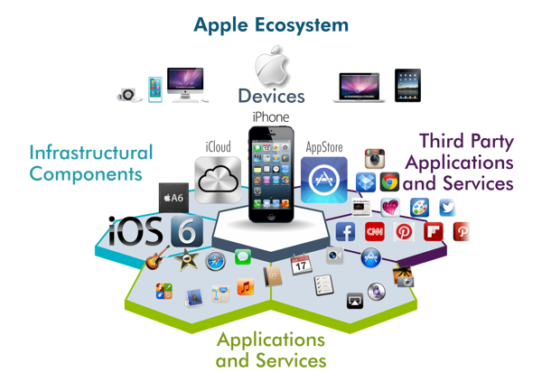
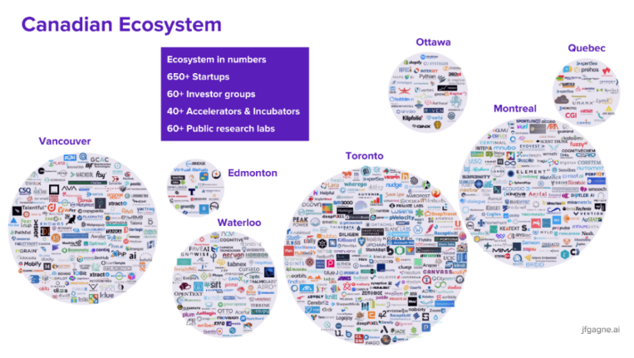
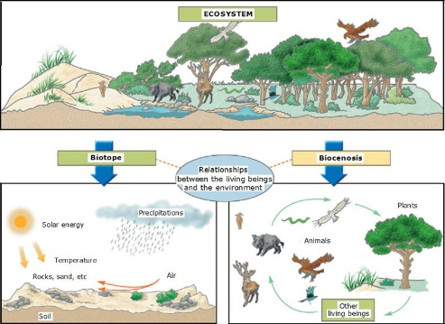
Ecosystem Types
Type 1: Natural Ecosystem
Type 2: Business Ecosystem
Type 3: Entrepreneurial Ecosystem

Slide 20
“Sustainable ecosystem Definition”
Entrepreneurial Ecosystem Definition
“a set of interdependent actors and factors coordinated in such a way that they enable productive entrepreneurship within a particular territory”
Stam and Spigel, 2016 p. 1
“an interconnected and collaborating group of stakeholders providing sustainability focused support to entrepreneurs in order to foster entrepreneurial activities and thereby contribute to the transformation to a sustainable regional economy”
(Bischoff and Volkmann, 2018, p. 186)
Qu’est-ce que l’écosystème entrepreneurial ? Fnege Media Dico Management Video ; Podcast
Webinar Understanding Entrepreneurial Ecosystems
ICSB Webinar, ICSB Resiliency Awards 2020
ICSB 2020
Notes:
Multidisciplinary combines several academic disciplines or professional approaches to examine the concept;
Cross-disciplinary involves viewing one discipline from the perspective of another;
Transdisciplinary is referring to more than one branch of knowledge.
The multi-, trans-, cross-disciplinary nature refers to the several origins of this concept deriving from biology, economy, geography, management, entrepreneurship etc. Hence, researchers from different disciplines have been interested in examining various types of ecosystems from different lens and perspectives including the configurations approaches (Spigel, 2017), network approach (Scott et al., 2022, Fernandes & Ferreira, 2022; Neumeyer & Santos, 2018); system approaches (Stam & Van de Ven, 2021; Roundy et al., 2018), process-based approaches (Spigel and Harrison, 2018), institutional approaches (Cloitre et al., 2022), multi-level approaches (Theodoraki & Messeghem, 2017), or even ecosystem as a method (Theodoraki, 2020; van Rijnsoever, 2022).
The holistic, multi-lateral, and inclusive view refers to the variety of ecosystem elements and their interactions as well as the different views to examine this concept. As a result, several studies have concentrated on specific aspects of the ecosystem, such as intermediaries and support organizations (Theodoraki et al., 2022b), funding entities (Spigel, 2022), or government (Wei, 2022), as an entry point for analysis. To supplement these challenges and develop a comprehensive understanding of entrepreneurial ecosystems, existing theories have explored them from various perspectives, including networks, strategy, process, and governance.

Slide 21
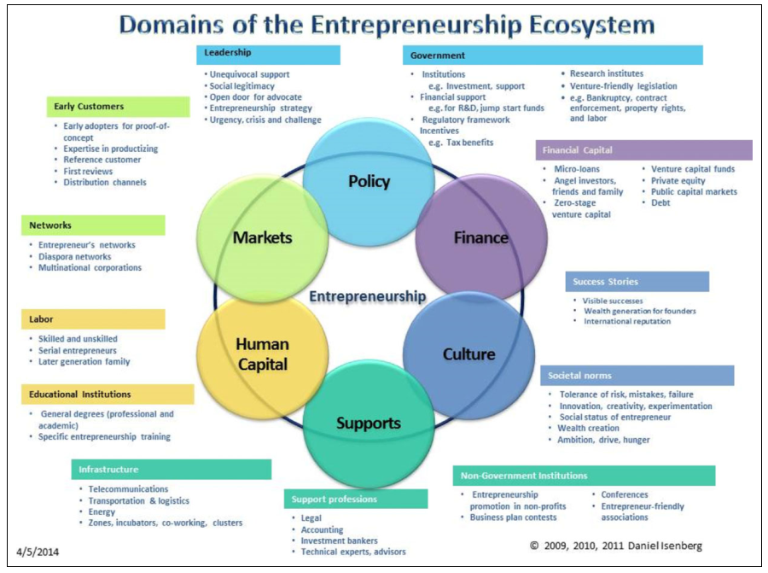
EE Main Components

Slide 22
Main Models - Tools and Tips

Slide 23
Ecosystem Layers: A Multi-level Phenomenon
Identify the level of analysis
Mega
International ecosystem
Macro
Entrepreneurial ecosystem
Ecosystem
Sub-ecosystems
Meso
Entrepreneurial Support Ecosystem
Firm-level ecosystems
Micro
Incubator Ecosystem
Firm Ecosystem
Theodoraki and Messeghem, 2017, p. 61 Exploring the entrepreneurial ecosystem in the field of entrepreneurial support: a multi-level approach, International Journal of Entrepreneurship and Small Business, 31(1), 47-66.

Slide 24
Ecosystem Configuration
Examine the ecosystem configuration
STRUCTURAL
Ties
Stability
Configuration
Shared goals and languages
COGNITIVE
Shared narratives
Trust
RELATIONAL
Norms
Members obligations
Identification
Theodoraki, Messeghem and Rice, 2018, p. 163 A Social Capital Approach to the Development of Sustainable Entrepreneurial Ecosystems: An Explorative Study, Small Business Economics, 51(1), 153-170
The Development of Sustainable Entrepreneurial Ecosystems through Social Capital: The Cases of Academic Incubators – Read the article HERE

Slide 25
Beyond the ecosystem boundaries

Slide 26
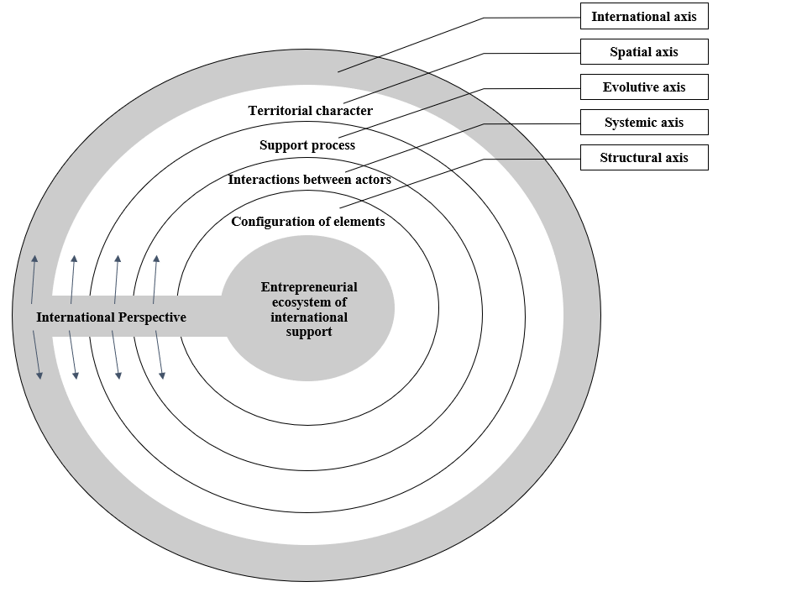
International Perspective
International perspective of the Entrepreneurial ecosystem
Theodoraki & Catanzaro (2022) Widening the borders of the entrepreneurial ecosystem through the international lens, The Journal of Technology Transfer, 47, 383-406.

Slide 27
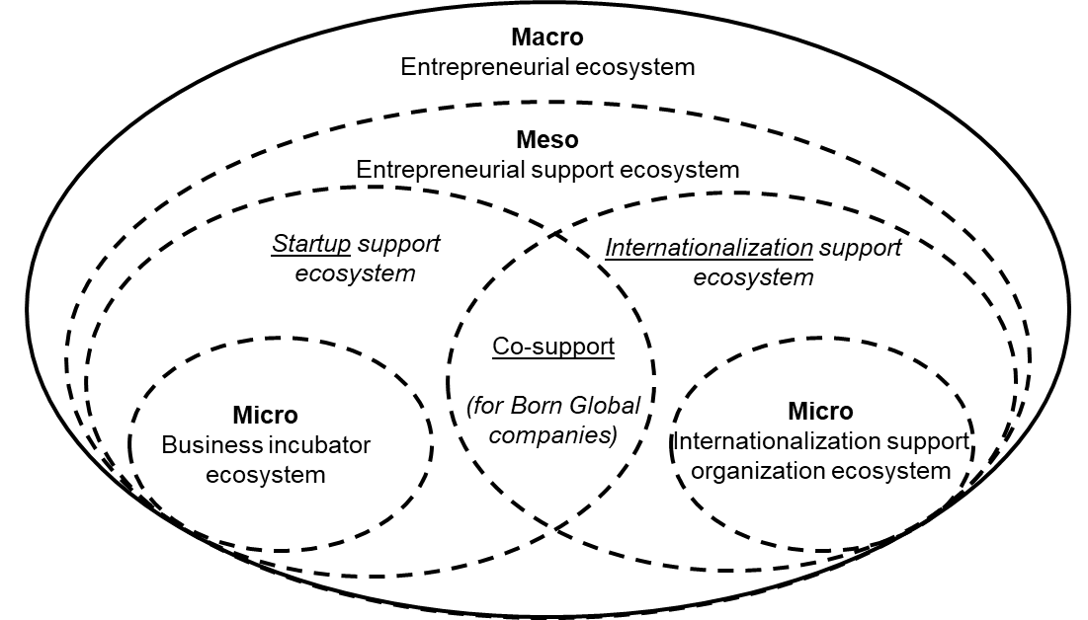
Entrepreneurial Sub-ecosystems
Model and interaction effects of the entrepreneurial sub-ecosystems
Theodoraki & Catanzaro (2022) Widening the borders of the entrepreneurial ecosystem through the international lens, The Journal of Technology Transfer, 47, 383-406.

Slide 28
Determine the ecosystem strategy
The Ecosystem Strategy

Slide 29
Exploring the Ecosystem Strategy
‘The incubator was built complementarily with the offer of regional services’ IM#Case_D#3
‘These are incubators that compete. It is an unfair competition as there are private and others are public’ C#Case_E#1
Finding #1: 10 major antecedents of cooperation and 12 major antecedents of competition
Finding #2: Competition and cooperation are influenced by:
Environmental or structural factors
Relational or competitive factors
Cognitive factors
Finding #3: Each type of incubators chooses different coopetition strategy
Theodoraki, 2020 A Holistic Approach to Incubator Strategies in the Entrepreneurial Support Ecosystem”, M@n@gement, 23(4), p. 13-27
Source: 48 interviews with ecosystem actors in the South of France, 2014

Slide 30
Adjusting the Ecosystem Strategy
Eco. dev. generalist
Institutionals (5,4)
Funding agencies (5,2)
Chambers of commerce (5,1)
Incubators (4,4)
Private experts (4,1)
Research entities (3,5)
TTOs (2,6)
Eco. dev. generalist
Chambers of commerce (3,9)
Incubators (3,3)
Private experts (2,6)
Institutionals (2,1)
TTOs (1,8)
Funding agencies (1,5)
Research entities (1,5)
Theodoraki et al., 2016, Labex Entreprendre
Source: 197 questionnaires with ecosystem actors in France, 2016

Slide 31
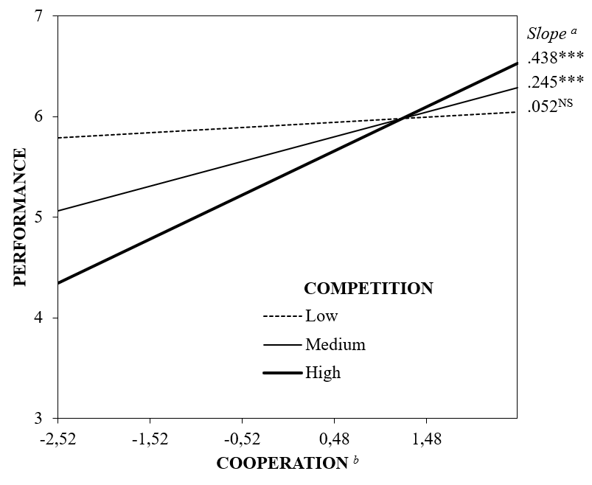
Outcomes of Ecosystem Strategy & Performance
Effects of Co-opetition on Incubator Performance
Theodoraki et al., 2020, IEEE TEM
Source: 156 questionnaires with incubators in France, 2016

Slide 32
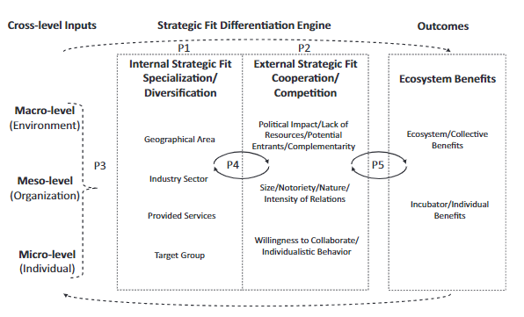
Exploring the Ecosystem Strategy
Cross-level strategic fit differentiation engine model
Une approche stratégique de l’écosystème entrepreneurial, FNEGE Media - Recherche, July 9th (in French) Video ; Podcast
Theodoraki, 2020, p. 22 A Holistic Approach to Incubator Strategies in the Entrepreneurial Support Ecosystem”, M@n@gement, 23(4), p. 13-27

Slide 33
Contextualizing Entrepreneurial Ecosystem
Awareness: Myths or Reality
Strategic elaboration
1
1
Silicon Valley Myth
Strategic Positioning
Ecosystem Analysis
Collective Strategic Analysis
Individual Strategic Analysis
Monitoring and Control
2
5
2
Old wine in new bottles myth
3
Ecosystem strategy development
Excluding myth
4
Equality myth
3
5
4
Love myth
6
Built in 1 day myth
Theodoraki, (2021) Ecosystème entrepreneurial académique : vers l’élaboration d’une stratégie écosystémique efficace, Revue internationale PME, 34(3-4), 68-89

Slide 34
Improve the Ecosystem sustainability
The Ecosystem Sustainability

Slide 35
Ecosystem Sustainability Loop
Adaptability to the local specificities
MATERIAL
Top-down & Bottom-up governance
ENTREPRENEURIAL ECOSYSTEM SUSTAINABILITY
Cooperation & Coopetition
How to Build a Sustainable Ecosystem: The Relevance of Governance and Coopetition – Read the article HERE
Theodoraki, 2019, ICSB Gazette, Best Article Top 9 Resiliency Awards 2020

Slide 36
Ecosystem Sustainability – ESG Framework
Environmental
Aligned with sustainable development goals (SDGs)
Liguori & Bendickson, 2020; Volkmann et al., 2021
ESG Framework
Siemieniako et al. (2021) and Higgins et al. (2020),
Social
Governance

Slide 37
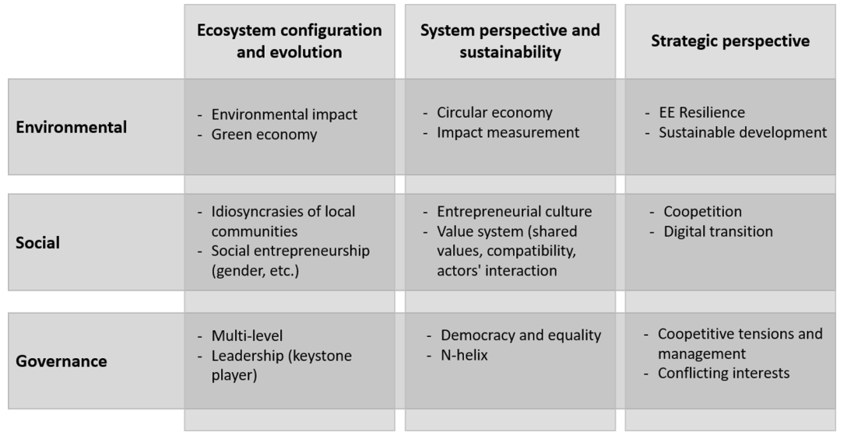
A holistic perspective of building sustainable entrepreneurial ecosystems
Theodoraki, Dana, Caputo, 2022 p. 355 Building sustainable entrepreneurial ecosystems: A holistic approach, Journal of Business Research, 140, 346-360.

Slide 38
Follow Ecosystem Research & Discussions

Slide 39
EE Book
📢[Book Launch + 30% Promotion code + Video] New book "Entrepreneurial Ecosystems in Cities and Regions: Emergence, Evolution, and Future" published by Oxford University Press 🚀 ✔️28 Chapters
✔️60 contributors across the countries and continents
✔️537 pages 👉Book info: https://lnkd.in/eHBsQBtw 💰 Promotion code ASFLYQ6 to save 30% 🎥 Video on FNEGE Médias: https://lnkd.in/eqTsBm5c 🎬 Video on YouTube: https://lnkd.in/egWQHGdA ➡️ Edited by Rob Huggins (Cardiff University / Prifysgol Caerdydd), Fumi Kitagawa (Birmingham Business School, University of Birmingham), Daniel Prokop (Cardiff University / Prifysgol Caerdyd), Christina Theodoraki (TBS Education), Piers Thompson (Nottingham Business School, Nottingham Trent University)

Slide 40
To go further ...
Understanding Entrepreneurial Ecosystems – Watch the video HERE
Entrepreneurial Ecosystems in Cities and Regions – Watch the video HERE
Entrepreneurial sourcing in the pre-incubation ecosystem, Critical perspectives on Entrepreneurial ecosystems, Cardiff University – Watch the video HERE
Exploration of the French Entrepreneurial Support Ecosystem, Labex Entreprendre Publications HERE
How to Build a Sustainable Ecosystem: The Relevance of Governance and Coopetition – Read the article HERE
The Development of Sustainable Entrepreneurial Ecosystems through Social Capital: The Cases of Academic Incubators – Read the article HERE

Slide 41
Key Take Away
Everyone wants to be like Silicon Valley
Favor top down decisions
Wait for money to build the ecosystem
Focus on the organization’s strategy
Isolate or remain passive
Pure cooperation/ Pure competition
Adapt to the local specificities
Promote bottom-up initiatives
Become an Ecosystem Builder TODAY!
Develop an ecosystem thinking & mindset
Foster the interaction between elements
Spread an entrepreneurial culture

Slide 42
Christina Theodoraki
PhD Professor in Entrepreneurship and Strategy
TBS Business School
c.theodoraki@tbs-education.fr

