Slide 1
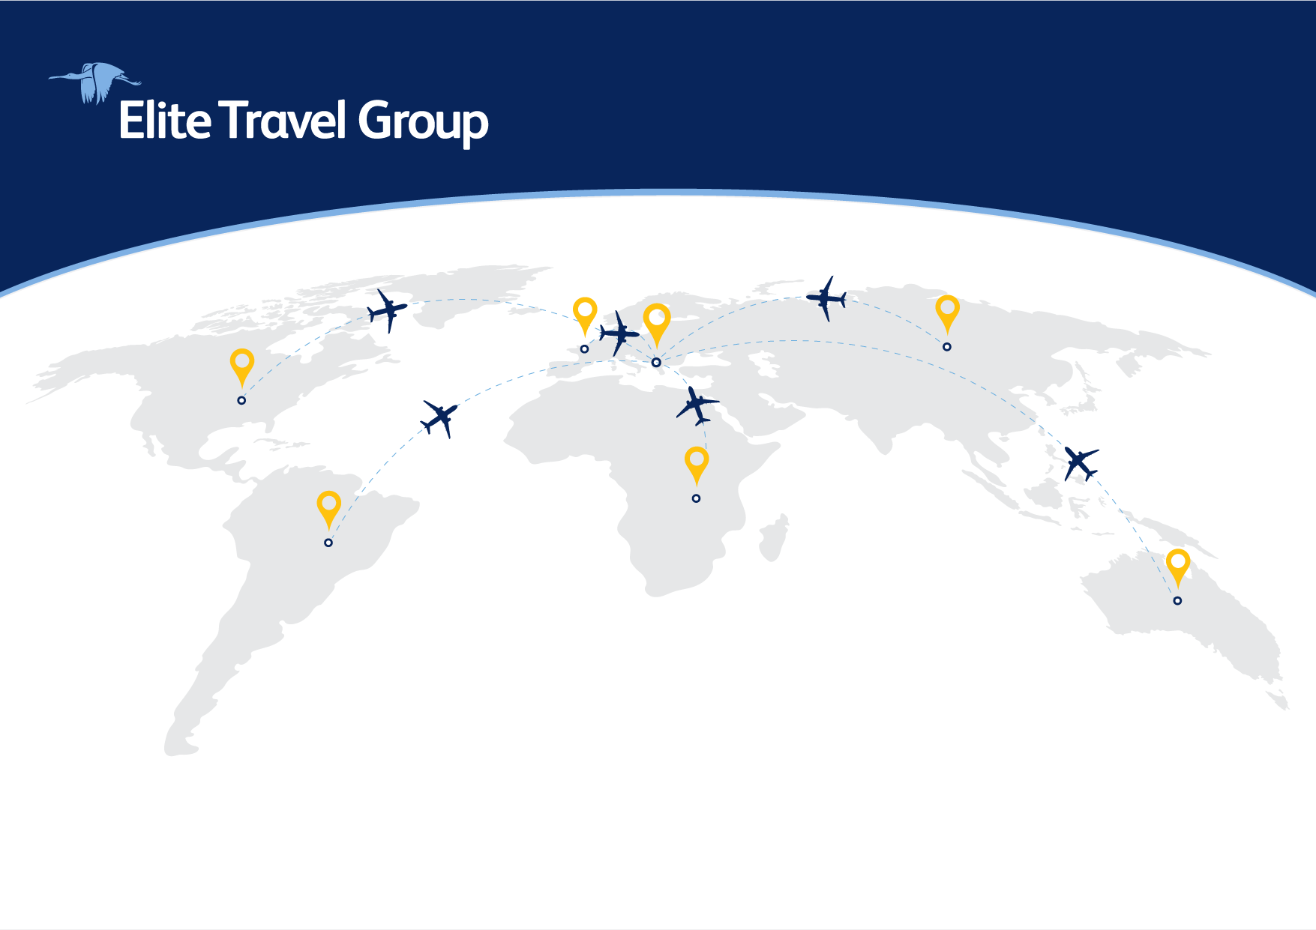
Titulli kryesor (32-50pt)
Ngjyrat paresore
Master text styles (18-20pt)
Second level (16-18 pt)
Third level (16pt)
Call to Action
Ngjyrat dytesore
The bright future of Hospitality and Tourism
Call to Action (Bold) / 24-44 pt
We welcome you !
Call to Action (Regular) / 24-44 pt
www.etg.al

Slide 2



Elite Travel Group is one of the longest established
and best known Travel Companies based in Albania.
Established in 2000, Elite DMC has a proven track record of providing the highest quality professional travel services in the Balkan region and Eastern Europe.
Notes:
Text slide 2:
Elite Travel Group is one of the longest established ​and best known Travel companies based in Albania. ​
Established in 2000, Elite DMC has a proven track record of providing the highest quality professional travel services in the Balkan region and Eastern Europe. ​

Slide 3
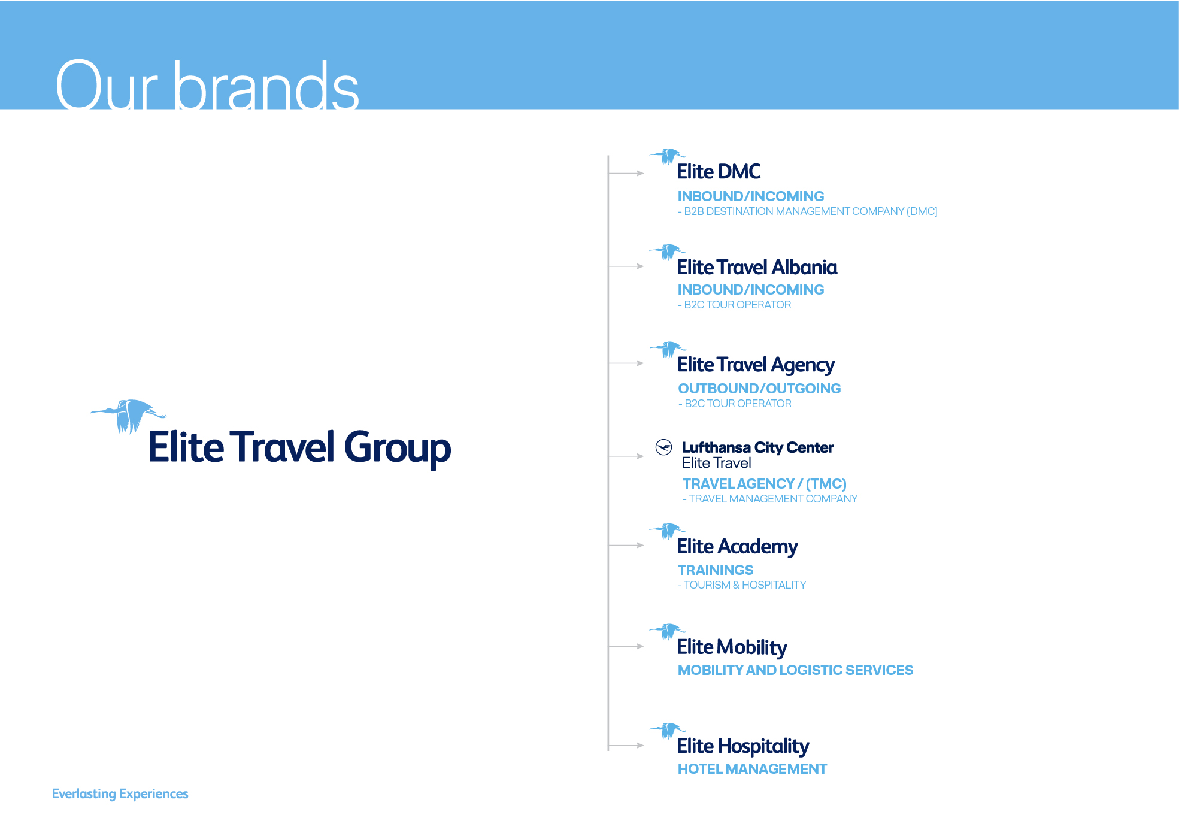

Slide 4

Values
Mission
Vision
Our business is built on respect. Respect for the planet, respect for our partners and respect for our customers. We don’t just want to do business; we want to make friends as we go.
We’re innovative, always looking for new ways to minimize our footprint. By being reliable, honest and transparent, we make sure our word is our bond.
And by focusing on quality, we make sure we’re delivering repeat business, which builds a sustainable future. It’s a whole new way to experience the travel business.
To give people the best of the Balkans and Eastern Europe.
And to do it in a sustainable way, working with local people to leave communities richer.
We aim to make money, but not at the expense of our other guiding principles. Our business is built on our people. So we treat them well and inspire them to be the best they can be. Our expertise helps people discover the best of the Balkans and Eastern Europe and encourages them to return and discover more.
We work with local communities and suppliers to build loyalty and trust. Planet: we only have one; all our activities aim to minimize their environmental impact and create stronger local communities.
To give people the best of the Balkans and Eastern Europe. And to do it in a sustainable way, working with local people to leave communities richer.
Notes:
Text slide 3:
Values
Our business is built on respect. Respect for the planet, respect for our partners and respect for our customers. We don’t just want to do business; we want to make friends as we go.
​
​We’re innovative, always looking for new ways to minimize our footprint. By being reliable, honest and transparent, we make sure our word is our bond. ​
​And by focusing on quality, we make sure we’re delivering repeat business, which builds a sustainable future. It’s a whole new way to experience the travel business. ​
Mission
To give people the best of the Balkans and Eastern Europe. ​
​
And to do it in a sustainable way, working with local people to leave communities richer.
Vision
We aim to make money, but not at the expense of our other guiding principles. Our business is built on our people. So we treat them well and inspire them to be the best they can be. Our expertise helps people discover the best of the Balkans and Eastern Europe and encourages them to return and discover more. ​​
We work with local communities and suppliers to build loyalty and trust. Planet: we only have one; all our activities aim to minimize their environmental impact and create stronger local communities. ​

Slide 5



Sustainability Statement
First Albanian travel company Travelife certified, by February 2022.
Sustainability Statement:
We decide to engage in the sustainability certification process
in order to learn, improve, implement and promote good sustainability practices on social, environmental and
economic aspects of our Business.
We will work and set actions to maximize positive impacts and minimize the negative impacts of our operations.
We aim to make tomorrow slightly better than yesterday,
positively influence, inspire and equally, respect with dignity our team members, clients, suppliers and partners to be an example of best practice in our country and the entire region.

Slide 6
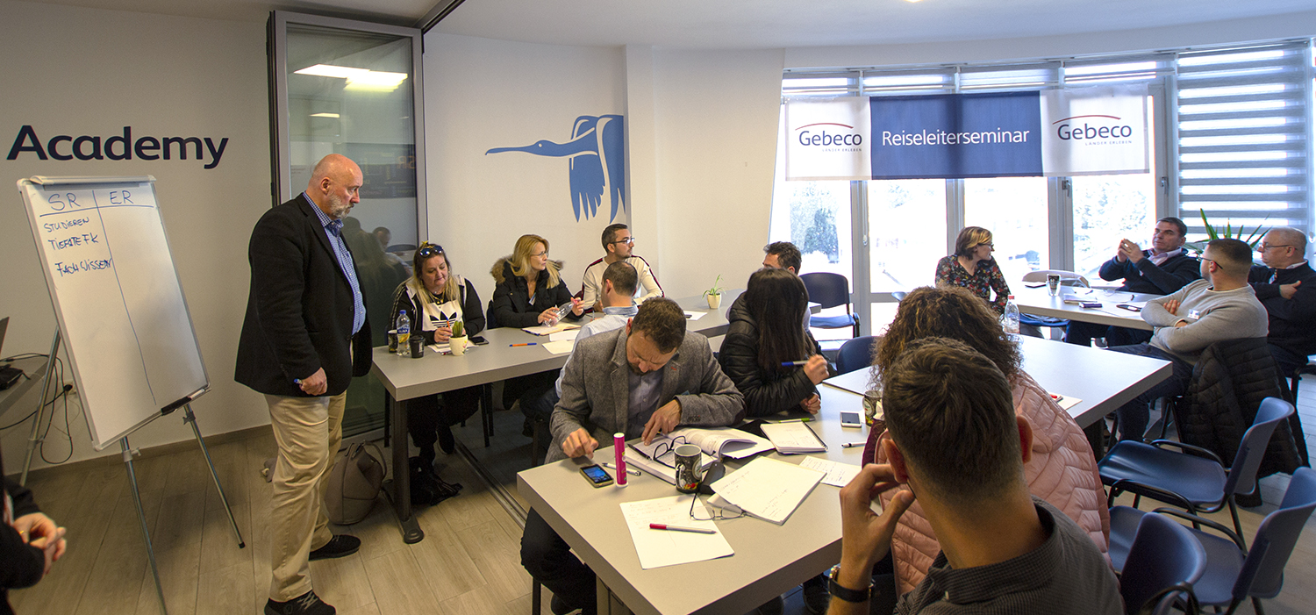
Education, our Corporate Social Responsibility
#1 in-class training
Begin with fundamental knowledge and guidelines
about the profession.
#2 practical experience and certification
Practical exercises and a final exam
will improve and test competences
acquired during the theoretical training.
#3 start working
Our colleagues are ready to use their knowledge gained into practice.

Slide 7


"As more and more artificial intelligence is entering into the world, more and more emotional intelligence must enter into leadership." -- Amit Ray, Famous AI Scientist, Author of Compassionate Artificial Intelligence

Slide 8



AI
Data analysis
BI
Artificial intelligence
Computer systems able to perform tasks normally requiring human intelligence, such as visual perception, speech recognition, decision-making, and translation between languages.
Data science
Analyzing raw data in order to make human – friendly conclusions.
Reveal trends and metrics that would otherwise be lost in the mass of information.
This information then used to optimize processes, to increase the overall efficiency of a business or system.
Business Intelligence
Technology-driven process for analyzing data and presenting actionable information which helps executives, managers and other corporate end users make informed business decisions.
BI technologies provide historical, current, and predictive views of business operations.
To give people the best of the Balkans and Eastern Europe. And to do it in a sustainable way, working with local people to leave communities richer.

Slide 9
By 2026 Elite Travel Group will be the first company in Albania to offer:
4 days a week job
No more seasonal jobs
- Hybrid work
Remote work
5 hours day job (08 – 13.00 or 13.00 – 18.00 for parents with kids under 12 yrs.
A guarantee that an employee of the company in case of any global disruption get paid for 1 year 70% of his salary
On interviews we will not ask for certification but deliver a task to be solved within a deadline.

Slide 10
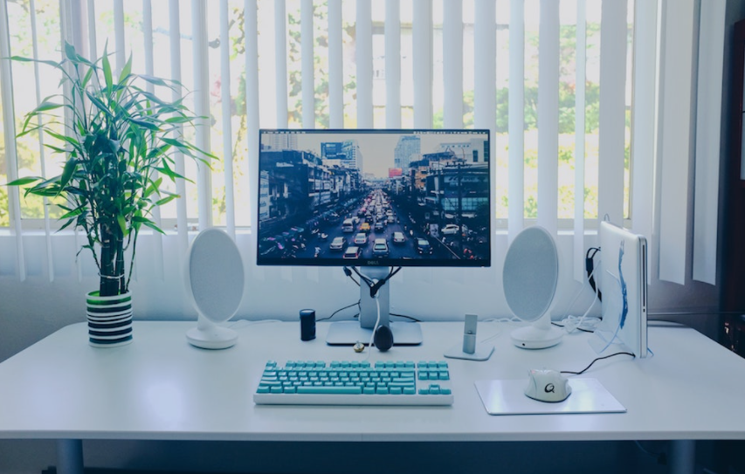
Tourism Industry in Albania
Free stress work by 2024

Slide 11
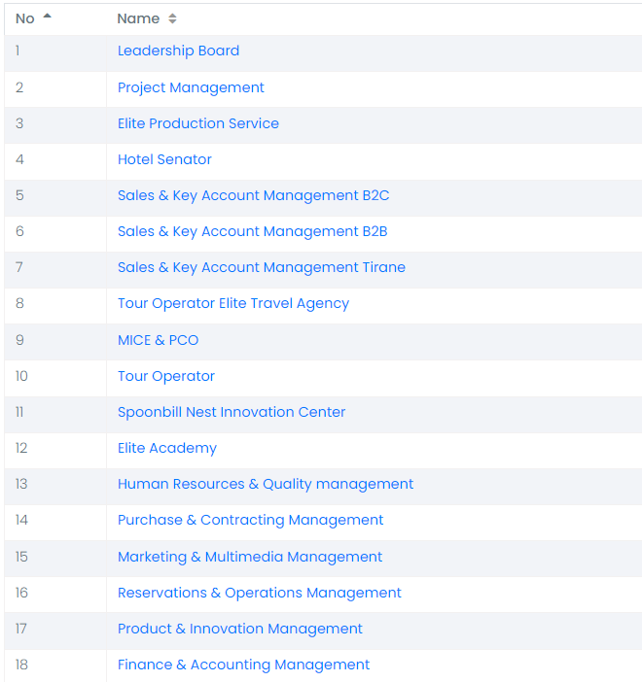
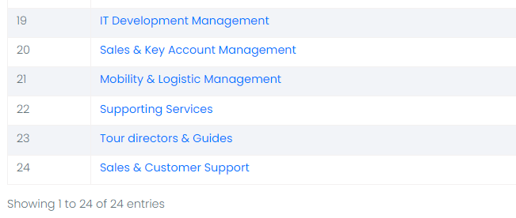

Slide 12
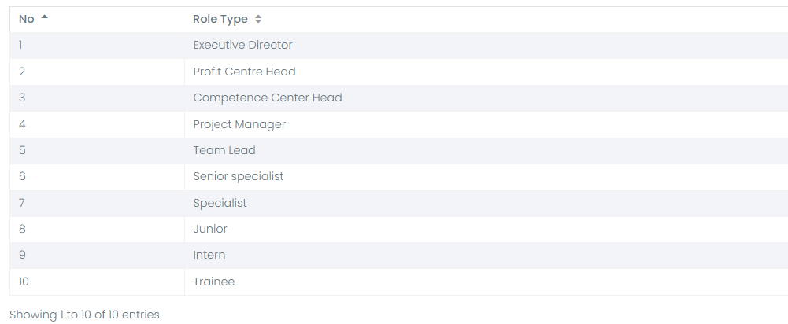
Your Journey?!
Guide/Waiter/Sales/Travel advisor/Reps

Slide 13
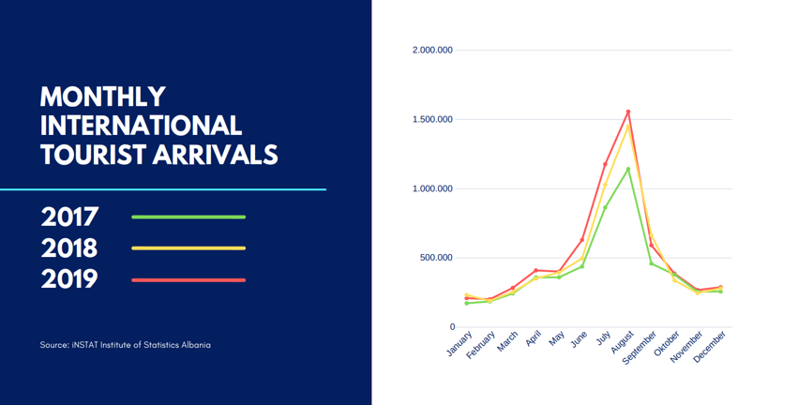
WWe must flatten this curve…
Notes:
By Simon Reuter

Slide 14
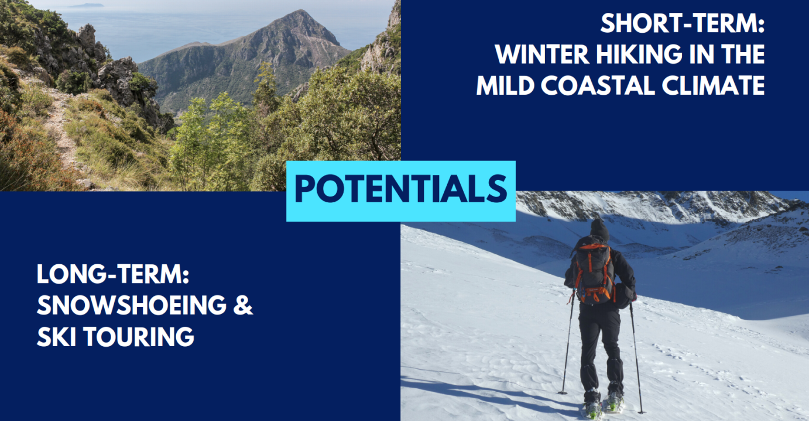
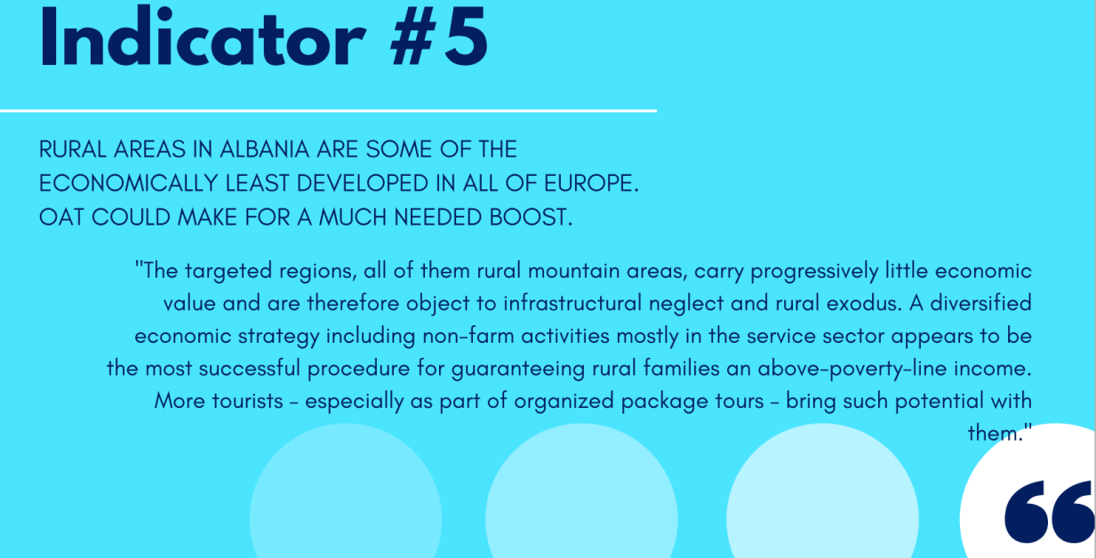
Education, our Corporate Social Responsibility
Notes:
By Simon Reuter

Slide 15
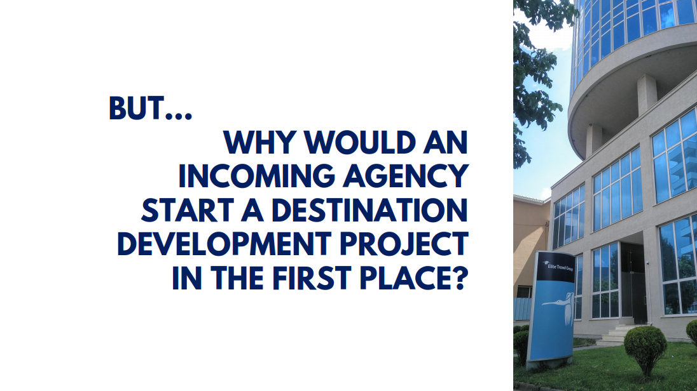
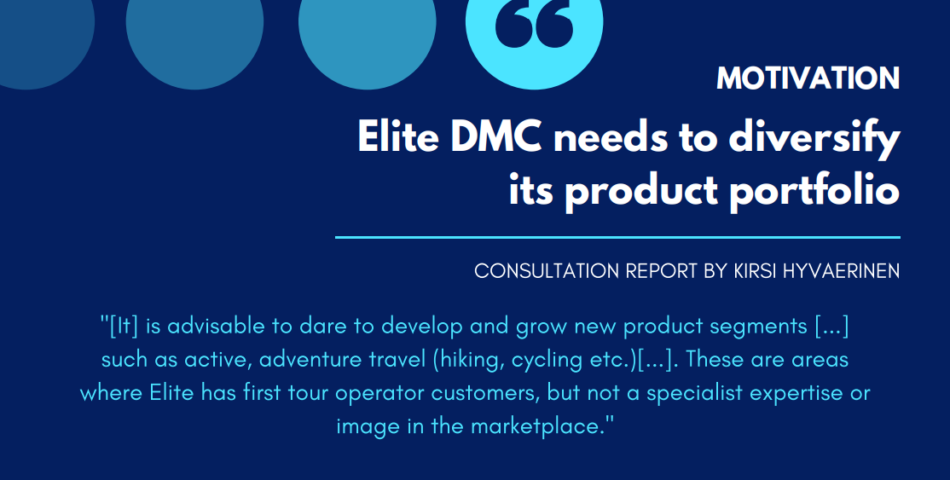

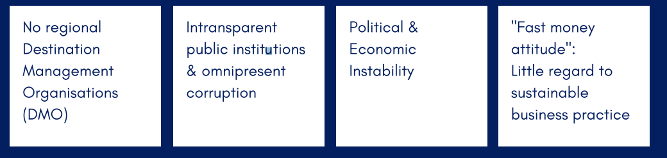
Education, our Corporate Social Responsibility

Slide 16
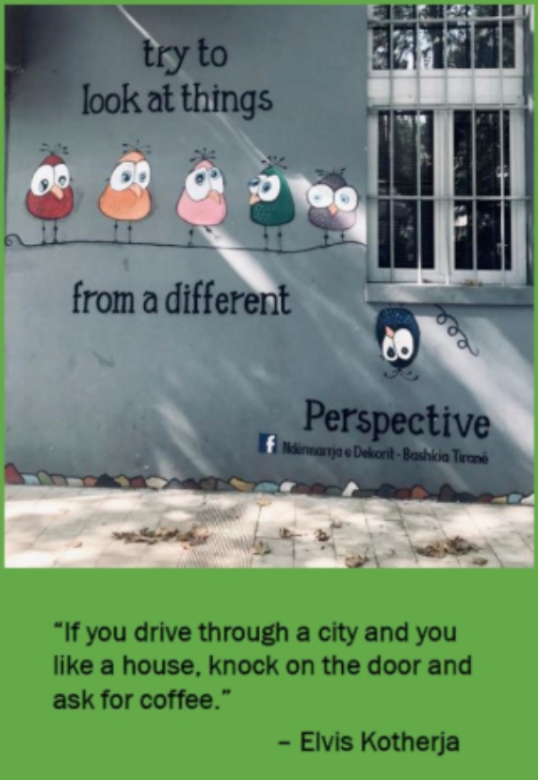
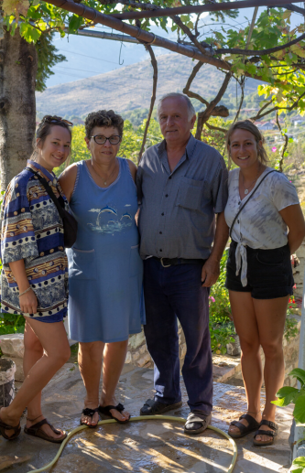
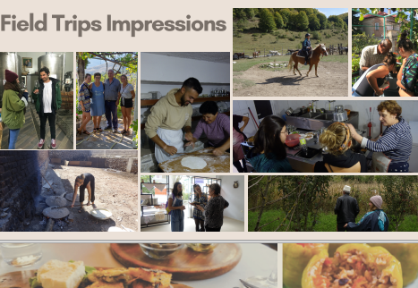

Slide 17
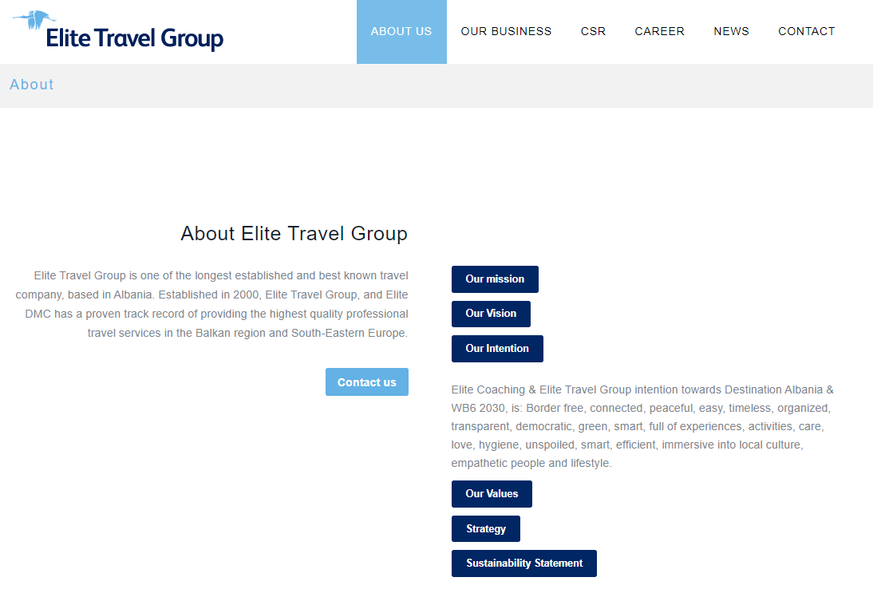
Elite Travel Group intetion: Albania & Western Balkans 2030

Slide 18


Education, our Corporate Social Responsibility
The most successful and reliable investment is to help communities, ROI will be higher than you think.

Slide 19


Q & A

Slide 20
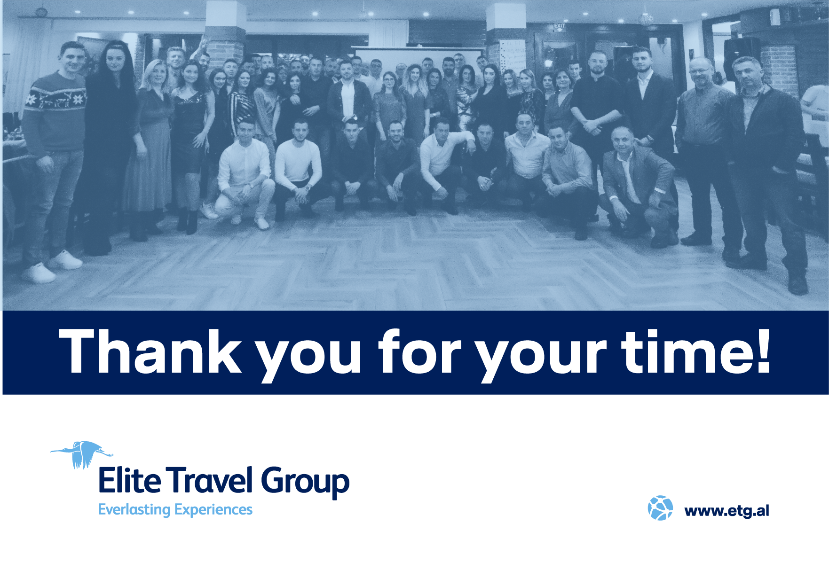
We welcome you to our region
and looking forward to inspire your colleagues and guests!

